Slide 1






DESIGN THINKING
HONG GRACE ENYING
HEW SIANG LING
GUAN DERONG
HONG WEI YANG

Slide 2


Knowledge trading platform
A secondhand book trading platform
DESIGN THINKING
You can also sell your notes
GUAN DERONG
HEW SIANG LING
HONG WEI YANG
HONG GRACE ENYING

Slide 3






Problem Background
Knowledge trading platform
HONG GRACE ENYING
A secondhand book trading platform
New textbooks and reference material are expensive for students
HONG WEI YANG
You can also sell your notes
GUAN DERONG
Limited channels to sell old textbooks
HEW SIANG LING
DESIGN THINKING

Slide 4





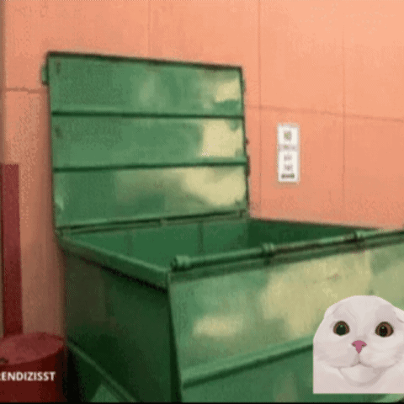
Knowledge trading platform
Problem Background
HONG GRACE ENYING
New textbooks and reference material are expensive for students
Information between buyers and sellers is fragmented and unmatched
HONG WEI YANG
GUAN DERONG
Limited channels to sell old textbooks
Old reference materials are dumped after the owner completed their studies
HEW SIANG LING
A secondhand book trading platform
You can also sell your notes

Slide 5


Solution
Create a safe and convenient second-hand textbook trading platform especially for university students.
Problem Background
HONG GRACE ENYING
Information between buyers and sellers is fragmented and unmatched
HONG WEI YANG
GUAN DERONG
Old reference materials are dumped after the owner completed their studies
HEW SIANG LING
New textbooks and reference material are expensive for students
Limited channels to sell old textbooks

Slide 6


Problem Background
Solution
HONG GRACE ENYING
Create a safe and convenient second-hand textbook trading platform especially for university students.
HONG WEI YANG
GUAN DERONG
HEW SIANG LING
Information between buyers and sellers is fragmented and unmatched
Old reference materials are dumped after the owner completed their studies

Slide 7
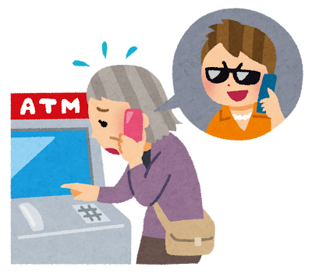




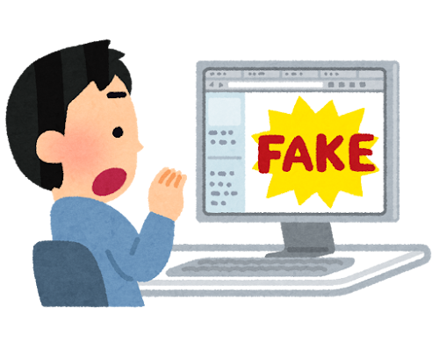



Analyze pain point
Solution
HONG GRACE ENYING
Fear of scams
Unclear pricing
Unclear book conditions
Create a safe and convenient second-hand textbook trading platform especially for university students.
RM50?
HONG WEI YANG
RM20?
OR
Difficulty finding trustworthy buyers or sellers
GUAN DERONG
HEW SIANG LING
Non-suitable study notes
Physics?
Math

Slide 8



Solution
Define
Analyze pain point
HONG GRACE ENYING
This is a trustworthy, easy-to-use, and efficient platform designed to help university students buy, sell, and match used textbooks and study notes.
Fear of scams
Unclear pricing
Unclear book conditions
RM50?
In short, the platform aims to solve the inherent inefficiencies and trust issues in traditional textbook transactions, creating a convenient and secure platform for students to trade secondhand academic materials.
HONG WEI YANG
RM20?
OR
Difficulty finding trustworthy buyers or sellers
GUAN DERONG
HEW SIANG LING
Non-suitable study notes
Physics?
Math
Create a safe and convenient second-hand textbook trading platform especially for university students.

Slide 9





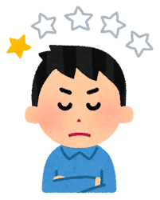
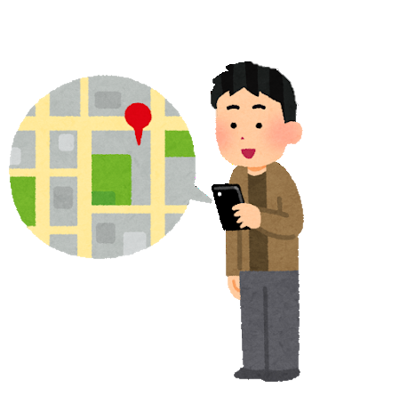

Analyze pain point
Idea
Define
HONG GRACE ENYING
Trust and rating system
This is a trustworthy, easy-to-use, and efficient platform designed to help university students buy, sell, and match used textbooks and study notes.
In short, the platform aims to solve the inherent inefficiencies and trust issues in traditional textbook transactions, creating a convenient and secure platform for students to trade secondhand academic materials.
HONG WEI YANG
Pick-up / drop-off points on campus
GUAN DERONG
HEW SIANG LING
RM50?
Physics?
Fear of scams
RM20?
Difficulty finding trustworthy buyers or sellers
Unclear pricing
Non-suitable study notes
Unclear book conditions
Math
OR

Slide 10







Define
Idea
HONG GRACE ENYING
Trust and rating system
Sort by course / subject / published year / price / condition
HONG WEI YANG
Auto price suggestion
Pick-up / drop-off points on campus
GUAN DERONG
RM20
RM35
RM15
HEW SIANG LING
In short, the platform aims to solve the inherent inefficiencies and trust issues in traditional textbook transactions, creating a convenient and secure platform for students to trade secondhand academic materials.
This is a trustworthy, easy-to-use, and efficient platform designed to help university students buy, sell, and match used textbooks and study notes.

Slide 11
Idea
HONG GRACE ENYING
Sort by course / subject / published year / price / condition
HONG WEI YANG
Auto price suggestion
GUAN DERONG
RM20
RM35
RM15
HEW SIANG LING
THANK YOU
HAVE A NICE DAY
Trust and rating system
Pick-up / drop-off points on campus

Slide 12
Idea
HONG GRACE ENYING
Sort by course / subject / published year / price / condition
THANK YOU
HAVE A NICE DAY
HONG WEI YANG
Auto price suggestion
GUAN DERONG
RM20
RM35
RM15
HEW SIANG LING

